Slide 1
Artificial Intelligence Lecture 22: Making Decisions (AIMA Chapters 16-17)
FALL 2018
Instructor: Prof Sheila Tejada

Slide 2
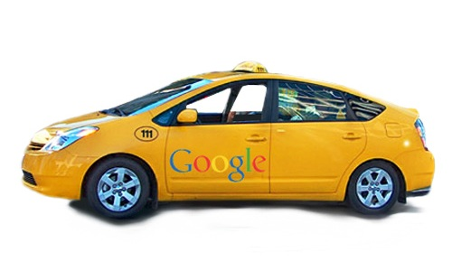
Automated Taxi
Should you wear your seat belt?
Let’s try a probabilistic approach

Slide 3
Bayesian Network
Should you wear your seat belt?
Let’s try a probabilistic approach
AutomatedTaxi
Accident
Seat Belt

Slide 4
Bayesian Network
Should you wear your seat belt?
Let’s try a probabilistic approach
AutomatedTaxi
Accident
Seat Belt

Slide 5
Bayesian Network
Should you wear your seat belt?
Let’s try a probabilistic approach
 | P(Accident)
Automated Taxi | 0.00000001
¬Automated Taxi | 0
AutomatedTaxi
Accident
Seat Belt

Slide 6
Bayesian Network
Should you wear your seat belt?
Let’s try a probabilistic approach
P(AT)
???
 | P(Accident)
Automated Taxi | 0.00000001
¬Automated Taxi | 0
AutomatedTaxi
Accident
P(SB)
???
Seat Belt

Slide 7
Decision Network
AutomatedTaxi & SeatBelt are not probabilistic events
You control whether they occur or not
Rectangular nodes
 | P(Accident)
Automated Taxi | 0.00000001
¬Automated Taxi | 0
Automated
Taxi
Accident
Seat Belt

Slide 8
Decision Network
AutomatedTaxi & SeatBelt are not probabilistic events
You control whether they occur or not
Rectangular nodes
P(Accident | AutomatedTaxi,SeatBelt) vs.
P(Accident | AutomatedTaxi,¬SeatBelt)
 | P(Accident)
Automated Taxi | 0.00000001
¬Automated Taxi | 0
Automated
Taxi
Accident
?
Seat Belt

Slide 9
Decision Network
AutomatedTaxi & SeatBelt are not probabilistic events
You control whether they occur or not
Rectangular nodes
P(Accident | AutomatedTaxi,SeatBelt) vs.
P(Accident | AutomatedTaxi,¬SeatBelt)
 | P(Accident)
Automated Taxi | 0.00000001
¬Automated Taxi | 0
Automated
Taxi
Accident
?
Seat Belt

Slide 10
Decision Network
AutomatedTaxi & SeatBelt are not probabilistic events
You control whether they occur or not
Rectangular nodes
P(Accident | AutomatedTaxi,SeatBelt) vs.
P(Accident | AutomatedTaxi,¬SeatBelt)
 | P(Accident)
Automated Taxi | 0.0000001
¬Automated Taxi | 0
Automated
Taxi
Accident
?
Seat Belt

Slide 11
Decision Network
Our decision depends on how bad the accident is
A small dent: No
Fatality: Yes
 | P(Accident)
Automated Taxi | 0.0000001
¬Automated Taxi | 0
Automated
Taxi
Accident
?
Seat Belt

Slide 12
Preferences
¬Accident ≻ Accident
“I prefer not getting into an accident.”
AutomatedTaxi ∼ RegularTaxi
“I am indifferent between automated and human-driven taxis.”
¬SeatBelt ≿ SeatBelt
You either prefer or are indifferent about not wearing a seat belt, but we know you don’t prefer wearing a seat belt to not.

Slide 13
Utility Nodes
Translate preferences into numeric values
Greater preference ⇔ Higher utility
 |  | Utility
Acc | SB | −5
Acc | ¬SB | −10⁸
¬Acc | SB | 5
¬Acc | ¬SB | 5.1
Automated
Taxi
Accident
Utility
Seat Belt

Slide 14
Decision Networks
Or influence diagrams
Bayesian network: Chance nodes
Action choices: Decision nodes
Outcome preferences: Utility node
Automated
Taxi
Accident
Utility
Seat Belt

Slide 15
Solving Decision Networks
Consider each possible set of decisions
Compute posterior probability¹ of utility node parents
Compute expected utility (EU)
Choose decisions with Maximum EU (MEU)
¹Just as in Bayesian networks
Automated
Taxi
Accident
Utility
Seat Belt

Slide 16
Decision Networks
Consider each possible set of decisions
Let’s assume AutomatedTaxi is True for now
We then have a choice of SeatBelt or ¬SeatBelt
Automated
Taxi
Accident
Utility
Seat Belt

Slide 17
Decision Networks
Compute posterior probability of utility node parents
e.g., P(Accident | AT ∧ ¬SB) = 0.00000001
Automated
Taxi
Accident
Utility
Seat Belt

Slide 18
Decision Networks
Compute expected utility (EU)
EU(AT∧¬SB) = P(Acc|AT∧¬SB)·U(Acc∧¬SB) +P(¬Acc|AT∧¬SB)·U(¬Acc∧¬SB)
= 0.00000001·(−10⁸) + 0.999999999·5.1 = 4.01 > 0
Automated
Taxi
Accident
Utility
Seat Belt

Slide 19
Decision Networks
Compute expected utility (EU)
EU(AT∧SB) = P(Acc|AT∧SB)·U(Acc∧SB) +P(¬Acc|AT∧SB)·U(¬Acc∧SB)
= 0.00000001·(−5) + 0.999999999·5 = 5.00
Automated
Taxi
Accident
Utility
Seat Belt

Slide 20
Decision Networks
Choose decision(s) with Maximum EU (MEU)
EU(AT∧¬SB) = 4.01 vs. EU(AT∧SB) = 5.00
Expected Utility is higher when SeatBelt is True
Automated
Taxi
Accident
Utility
Seat Belt

Slide 21
Alarm Bayesian Network
P(B)
0.001
P(E)
0.002
Burglary
Earthquake
 |  | P(A)
B | E | 0.95
B | ¬E | 0.94
¬B | E | 0.29
¬B | ¬E | 0.001
Alarm
 | P(M)
A | 0.70
¬A | 0.01
 | P(J)
A | 0.90
¬A | 0.05
JohnCalls
MaryCalls

Slide 22
Alarm Decision Network
Burglary
Earthquake
Call Police
Alarm
Utility
 |  | Utility
B | CP | 0
B | ¬CP | −100
¬B | CP | −5
¬B | ¬CP | 0
JohnCalls
MaryCalls

Slide 23
Expected Utility (EU)
Burglary
Earthquake
Call Police
Alarm
Utility
 |  | Utility
B | CP | 0
B | ¬CP | −100
¬B | CP | −5
¬B | ¬CP | 0
JohnCalls
MaryCalls

Slide 24
Maximum Expected Utility (MEU)
Burglary
Earthquake
Call Police
Alarm
Utility
 |  | Utility
B | CP | 0
B | ¬CP | −100
¬B | CP | −5
¬B | ¬CP | 0
JohnCalls
MaryCalls

Slide 25
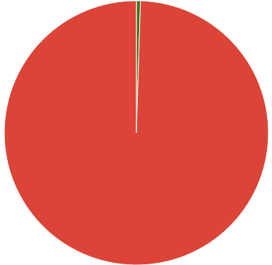
MEU Case 1
John calls, but Mary doesn’t. Should we call 911?
P(B | J, ¬M) = 0.005
P(¬B | J, ¬M) = 0.995
Smart variable ordering, because it doesn’t depend on CP
EU(CP|J,¬M) = P(B|J,¬M)·U(B,CP)+P(¬B|J,¬M)·U(¬B,CP)
= 0.005·0 + 0.995·(−5) = −4.975
EU(¬CP|J,¬M) = P(B|J,¬M)·U(B,¬CP)+P(¬B|J,¬M)·U(¬B,¬CP)
= 0.005·(−100) + 0.995·0 = −0.500
MEU: EU(¬CP|J,¬M) > EU(CP|J,¬M)
So don’t call the police

Slide 26
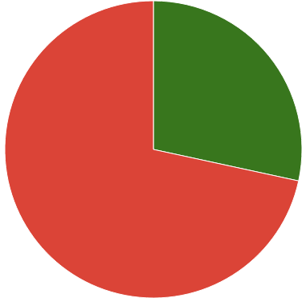
MEU Case 2
What if they both call?
P(B | J, M) = 0.284
P(¬B | J, M) = 0.716
EU(CP|J,M) = P(B|J,M)·U(B,CP)+P(¬B|J,M)·U(¬B,CP)
= 0.284·0 + 0.716·(−5) = −3.58
EU(¬CP|J,M) = P(B|J,M)·U(B,¬CP)+P(¬B|J,M)·U(¬B,¬CP)
= 0.284·(−100) + 0.716·0 = −28.4
MEU: EU(CP|J,M) > EU(¬CP|J,M)
So do call the police

Slide 27
The Utility of Money
Would you choose to buy a $1 ticket for:
[0.01, $10; 0.99, $0]
[0.001, $100; 0.999, $0]
[10⁻⁷, $10⁶; 1−10⁻⁷, $0]
Is it irrational to play the lottery?
If your expected utility is your expected winnings, then yes.
But if your utility for $1M is much more than 10⁶ times as high as your utility for $1, then no.
Money ≠ Utility

Slide 28
16.15 Making Simple Decisions
Consider a student who has the choice to buy or not buy a textbook for a course. We’ll model this as a decision problem with one Boolean decision node, B, indicating whether the agent chooses to buy the book, and two Boolean chance nodes, M, indicating whether the student has mastered the material in the book, and P , indicating whether the student passes the course. Of course, there is also a utility node, U. A certain student, Sam, has an additive utility function: 0 for not buying the book and -$100 for buying it; and $2000 for passing the course and 0 for not passing. Sam’s conditional probability estimates are as follows:
P(p|b,m) = 0.9
P(m|b) = 0.9
P (p|b, ¬m) = 0.5
P (m|¬b) = 0.7
P(p|¬b, m) = 0.8
P (p|¬b, ¬m) = 0.3
You might think that P would be independent of B given M, But this course has an open- book final—so having the book helps.

Slide 29
Draw the decision network for this problem.

Slide 30
Compute the expected utility of buying the book and of not buying it.

Slide 31
Compute the expected utility of buying the book and of not buying it.
0.35 x 0
BUY!

Slide 32
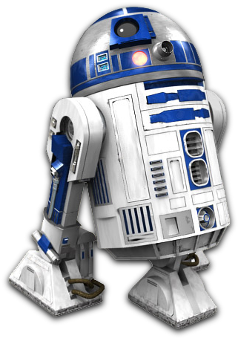
Decision Making Over Time
A robot planning its moves through a grid
1 | 2 | 3 | 4
5 |  | 6 | 7
8 | 9 | 10 | 11

Slide 33
Chance Nodes
The robot’s position
Domain = {1, 2, 3, 4, 5, 6, 7, 8, 9, 10, 11}
The possible squares the robot can be in
Changes each time the robot moves
A series of positions over time
X₀: The robot’s initial position
X₁: The robot’s position after 1 move
X₂: The robot’s position after 2 moves
...

Slide 34
Dynamic Decision Network
Robot chooses an action at each point in time
Up, down, left, or right
Move succeeds with 80% chance
10% chance of moving 90° or 270° from intended direction
If move would go through a wall, robot stays put
Move_{t-1}
X_{t-1}
X_{t}

Slide 35
Dynamic Decision Network
Move_{t-1}
X_{t-1}
X_{t}
X_{t-1} | M_{t-1} | P(X_{t}=1) | P(X_{t}=2) | P(X_{t}=3) | P(X_{t}=4) | P(X_{t}=5) | ...
1 | U | 0.9 | 0.1 | 0.0 | 0.0 | 0.0
1 | D | 0.1 | 0.1 | 0.0 | 0.0 | 0.8
1 | L | 0.9 | 0.0 | 0.0 | 0.0 | 0.1
1 | R | 0.1 | 0.8 | 0.0 | 0.0 | 0.1
2 | U | 0.1 | 0.8 | 0.1 | 0.0 | 0.0
...

Slide 36
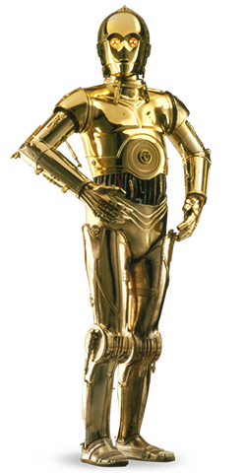
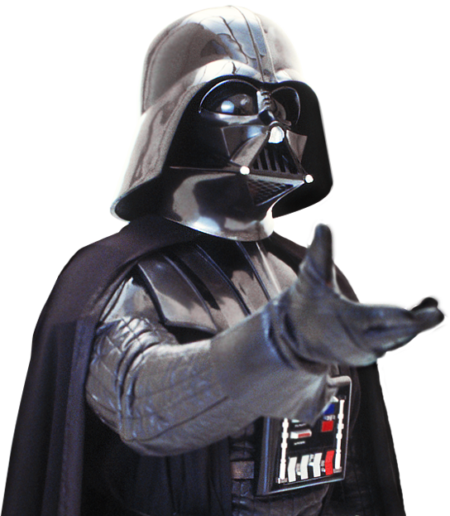
Terminal States
Robot’s journey ends if it reaches either one
1 | 2 | 3 | 4
5 |  | 6 | 7
8 | 9 | 10 | 11

Slide 37
Terminal States
Robot’s journey ends if it reaches either one
1 | 2 | 3 | 4
5 |  | 6 | 7
8 | 9 | 10 | 11
+1
-1

Slide 38
Dynamic Influence Diagram
X_{t} | Utility
4 | +1
7 | -1
Else | -0.04
Stationary Preferences
Utility is the same over time
Move_{t-1}
Utility
X_{t-1}
X_{t}

Slide 39
Markov Decision Process
An MDP consists of:
S: states (e.g., X or Battery)
A: actions (e.g., Move)
P(s’|s,a): transition model (e.g., P(X_{t} =s’ | X_{t-1}=s, Move_{t-1}=a)
R(s) or R(s,a): reward (e.g., Utility(X_{t} =s))
Problem: Finding an optimal policy, 𝜋*
Not enough to pick just a single best move
Must pick a policy, 𝜋(s): S→A
What action should the robot choose in each state?
The optimal policy maximizes Utility^{𝜋}(s₀)
What’s the policy that gives us the highest utility from our start?

Slide 40
Policy
1 | 2 | 3 | 4
5 |  | 6 | 7
8 | 9 | 10 | 11

Slide 41
Utility of a Policy: Infinite Horizon
Robot keeps on operating
Utility^{𝜋}(s) = E[R(S₀)+R(S₁)+...]
Utility^{𝜋}_{N}(s) = R(s)+E[R(S₁)+...]
Utility^{𝜋}_{N}(s) = R(s)+∑_{s1}(P(s₁|s,a)·R(s₁)+E[R(S₂)+...])
Utility^{𝜋}_{N}(s) = R(s)+∑_{s1}(P(s₁|s,𝜋_{N}(s))·R(s₁)+E[R(S₂)+...])
Utility^{𝜋}_{N}(s) = R(s)+∑_{s1}(P(s₁|s,𝜋(s))·Utility^{𝜋}(s₁))

Slide 42
Utility of a Policy: Infinite Horizon
Utility^{𝜋}(s) = E[R(S₀)+R(S₁)+...]
Utility^{𝜋}_{N}(s) = R(s)+∑_{s1}(P(s₁|s,𝜋(s))·Utility^{𝜋}(s₁))
Potentially unbounded!
Use a discount factor, 𝛾≤1
Utility^{𝜋}(s) = E[R(S₀)+𝛾R(S₁)+𝛾²R(S₂)+...]
Utility^{𝜋}_{N}(s) = R(s)+𝛾∑_{s1}(P(s₁|s,𝜋(s))·Utility^{𝜋}(s₁))
Reward now is better than reward later
Utility and 𝜋 are stationary

Slide 43
Computing Expected Utility
Utility^{𝜋}(4) = +1 Utility^{𝜋}(7) = −1
1 | 2 | 3 | 4
5 |  | 6 | 7
8 | 9 | 10 | 11

Slide 44
Computing Expected Utility
𝜋(3) = Right 𝛾=1
1 | 2 | 3 | 4
5 |  | 6 | 7
8 | 9 | 10 | 11

Slide 45
Computing Expected Utility
U^{𝜋}(3) = R(3)+𝛾∑_{s1}(P(s₁|3,Right)·U^{𝜋}(s₁))
1 | 2 | 3 | 4
5 |  | 6 | 7
8 | 9 | 10 | 11

Slide 46
Computing Expected Utility
U^{𝜋}(3) = R(3)+𝛾P(4|3,Right)·U^{𝜋}(4))+𝛾P(6|3,Right)·U^{𝜋}(6)) +𝛾P(3|3,Right)·U^{𝜋}(3))
1 | 2 | 3 | 4
5 |  | 6 | 7
8 | 9 | 10 | 11

Slide 47
Computing Expected Utility
U^{𝜋}(3) = −.04+1·0.8·1+1·0.1·U^{𝜋}(6)+1·0.1·U^{𝜋}(3)
1 | 2 | 3 | 4
5 |  | 6 | 7
8 | 9 | 10 | 11

Slide 48
Computing Expected Utility
𝜋(6) = Up
1 | 2 | 3 | 4
5 |  | 6 | 7
8 | 9 | 10 | 11

Slide 49
Computing Expected Utility
U^{𝜋}(6) = R(6)+𝛾0.8·U^{𝜋}(3))+𝛾0.1·U^{𝜋}(7))+𝛾0.1·U^{𝜋}(6))
1 | 2 | 3 | 4
5 |  | 6 | 7
8 | 9 | 10 | 11

Slide 50
Computing Expected Utility
𝜋(6) = Left
1 | 2 | 3 | 4
5 |  | 6 | 7
8 | 9 | 10 | 11

Slide 51
Computing Expected Utility
U^{𝜋}(6) = R(6)+𝛾0.1·U^{𝜋}(3))+𝛾0.8·U^{𝜋}(6))+𝛾0.1·U^{𝜋}(10))
1 | 2 | 3 | 4
5 |  | 6 | 7
8 | 9 | 10 | 11

Slide 52
Value Iteration
Bellman equation
In each state, choose the action with highest utility
U(s) = R(s)+𝛾max_{a}∑_{s1}(P(s₁|s,a)U(s₁))
Repeating this formula will converge to optimal policy
U₀(s) = R(s)
U_{i}(s) = R(s)+𝛾max_{a}∑_{s1}(P(s₁|s,a)U_{i-1}(s₁))
Bellman update
As i→∞, U_{i}→U
See AIMA 17.2.3 for details
𝜋*(s) = arg max_{a}∑_{s1}(P(s₁|s,a)U(s₁))

Slide 53
Value Iteration
1 | 2 | 3 | 4
5 |  | 6 | 7
8 | 9 | 10 | 11
−.04
−.04
−.04
+1
−.04
−.04
−1
−.04
−.04
−.04
−.04

Slide 54
Value Iteration
1 | 2 | 3 | 4
5 |  | 6 | 7
8 | 9 | 10 | 11
−.04
−.04
−.04
+1
−.04
−.04
−1
−.04
−.04
−.04
−.04

Slide 55
Value Iteration
U: −.08
D: −.08
L: −.08
R: −.08
1 | 2 | 3 | 4
5 |  | 6 | 7
8 | 9 | 10 | 11
−.04
−.04
+1
−.04
−.04
−1
−.04
−.04
−.04
−.04

Slide 56
Value Iteration
1 | 2 | 3 | 4
5 |  | 6 | 7
8 | 9 | 10 | 11
−0.08
𝜋*(1)=∗
−.04
−.04
+1
−.04
−.04
−1
−.04
−.04
−.04
−.04

Slide 57
Value Iteration
1 | 2 | 3 | 4
5 |  | 6 | 7
8 | 9 | 10 | 11
U: 0.024
−.04
−.04
+1
−.04
−.04
−1
−.04
−.04
−.04
−.04

Slide 58
Value Iteration
1 | 2 | 3 | 4
5 |  | 6 | 7
8 | 9 | 10 | 11
D: 0.024
−.04
−.04
+1
−.04
−.04
−1
−.04
−.04
−.04
−.04

Slide 59
Value Iteration
1 | 2 | 3 | 4
5 |  | 6 | 7
8 | 9 | 10 | 11
L: −0.08
−.04
−.04
+1
−.04
−.04
−1
−.04
−.04
−.04
−.04

Slide 60
Value Iteration
1 | 2 | 3 | 4
5 |  | 6 | 7
8 | 9 | 10 | 11
R: 0.752
−.04
−.04
+1
−.04
−.04
−1
−.04
−.04
−.04
−.04

Slide 61
Value Iteration
1 | 2 | 3 | 4
5 |  | 6 | 7
8 | 9 | 10 | 11
U: 0.024
D: 0.024
L: −0.08
R: 0.752
−.04
−.04
+1
−.04
−.04
−1
−.04
−.04
−.04
−.04

Slide 62
Value Iteration
1 | 2 | 3 | 4
5 |  | 6 | 7
8 | 9 | 10 | 11
0.752
𝜋*(3)=R
−.04
−.04
+1
−.04
−.04
−1
−.04
−.04
−.04
−.04

Slide 63
Value Iteration
1 | 2 | 3 | 4
5 |  | 6 | 7
8 | 9 | 10 | 11
−.04
−.04
−.04
+1
−.04
−.04
−1
−.04
−.04
−.04
U: −.848

Slide 64
Value Iteration
1 | 2 | 3 | 4
5 |  | 6 | 7
8 | 9 | 10 | 11
−.04
−.04
−.04
+1
−.04
−.04
−1
−.04
−.04
−.04
D: −.08

Slide 65
Value Iteration
1 | 2 | 3 | 4
5 |  | 6 | 7
8 | 9 | 10 | 11
−.04
−.04
−.04
+1
−.04
−.04
−1
−.04
−.04
−.04
L: −.176

Slide 66
Value Iteration
1 | 2 | 3 | 4
5 |  | 6 | 7
8 | 9 | 10 | 11
−.04
−.04
−.04
+1
−.04
−.04
−1
−.04
−.04
−.04
R: −.176

Slide 67
Value Iteration
1 | 2 | 3 | 4
5 |  | 6 | 7
8 | 9 | 10 | 11
−.04
−.04
−.04
+1
−.04
−.04
−1
U: −.848
L: −.176
D: −.08
R: −.176
−.04
−.04
−.04

Slide 68
Value Iteration
1 | 2 | 3 | 4
5 |  | 6 | 7
8 | 9 | 10 | 11
−.04
−.04
−.04
+1
−.04
−.04
−1
−0.08
𝜋*(11)=D
−.04
−.04
−.04

Slide 69
Final Values
.812
.868
.918
+1
.762
.660
-1
.705
.655
.611
.388

Slide 70
Final Policy
.812
𝜋*(1)=R
.868
𝜋*(2)=R
.918
𝜋*(3)=R
+1
.762
𝜋*(5)=U
.660
𝜋*(6)=L
-1
.705
𝜋*(8)=U
.655
𝜋*(9)=L
.611
𝜋*(10)=L
.388
𝜋*(11)=L

Slide 71
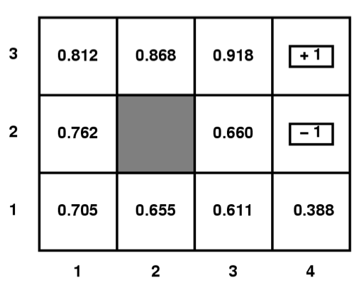
MDP
50
500
Given a Gridworld domain, where terminal states
(1,3), (4,3), and (4,2) have rewards 50, 500, and -50
respectively, the set of possible actions are
{N,E,S,W, or X for terminal states},
the agent moves deterministically,
all V and Q values for non terminal
states have been initialized to 0,
answer the questions below.
Circle the letter that corresponds to the best answer for the question.
What are the optimal values, V∗ of each state in the above grid if γ = 0.5, c(a)=0, R(s)=0 for non terminal states?
(Remember V_{t+1}(s) = R(s) + Max_{aεA} {c(a)+γΣ_{s’εS} P(s’|a,s) V_{t}(s’)} )
V_{(1,1)}=15.75, V_{(1,2)}=25, V_{(2,1)}=31.25, V_{(2,3)}=125, V_{(3,1)}=62.5, V_{(3,2)}=125, V_{(3,3)}=250, V_{(4,1)}=25
V_{(1,1)}=12.5, V_{(1,2)}=25, V_{(2,1)}=31.25, V_{(2,3)}=125, V_{(3,1)}=62.5, V_{(3,2)}=125, V_{(3,3)}=250, V_{(4,1)}=31.25
V_{(1,1)}=15.625, V_{(1,2)}=25, V_{(2,1)}=31.25, V_{(2,3)}=125, V_{(3,1)}=62.5, V_{(3,2)}=125, V_{(3,3)}=250, V_{(4,1)}=31.25
V_{(1,1)}=12.5, V_{(1,2)}=25, V_{(2,1)}=25, V_{(2,3)}=25, V_{(3,1)}=50, V_{(3,2)}=100, V_{(3,3)}=250, V_{(4,1)}=25
None of the above
-50
C

Slide 72
MDP
What are the Q values of state (3,2) in the above grid if γ = 0.5, c(a)=0, R(s)=-2 for non terminal states?
(Remember Q_{t+1}(a,s) = R(s) + c(a)+γΣ_{s’εS} P(s’|a,s)max_{a’εA} Q_{t}(a’s’) )
Q_{((3,2),N)}=122, Q_{((3,2),E)}=-27, Q_{((3,2),S)}=59
Q_{((3,2),N)}=122, Q_{((3,2),E)}=-27, Q_{((3,2),S)}=27.5
Q_{((3,2),N)}=125, Q_{((3,2),E)}=-25, Q_{((3,2),S)}=62.5
Q_{((3,2),N)}=120, Q_{((3,2),E)}=-27, Q_{((3,2),S)}=31.5
None of the above
500
50
500
50
-50
-50

Slide 73
MDP
What are the Q values of state (3,2) in the above grid if γ = 0.5, c(a)=0, R(s)=-2 for non terminal states?
(Remember Q_{t+1}(a,s) = R(s) + c(a)+γΣ_{s’εS} P(s’|a,s)max_{a’εA} Q_{t}(a’s’) )
Q_{((3,2),N)}=122, Q_{((3,2),E)}=-27, Q_{((3,2),S)}=59
Q_{((3,2),N)}=122, Q_{((3,2),E)}=-27, Q_{((3,2),S)}=27.5
Q_{((3,2),N)}=125, Q_{((3,2),E)}=-25, Q_{((3,2),S)}=62.5
Q_{((3,2),N)}=120, Q_{((3,2),E)}=-27, Q_{((3,2),S)}=31.5
None of the above
50
E248
500
-50

Slide 74
MDP
What are the Q values of state (3,2) in the above grid if γ = 0.5, c(a)=0, R(s)=-2 for non terminal states?
(Remember Q_{t+1}(a,s) = R(s) + c(a)+γΣ_{s’εS} P(s’|a,s)max_{a’εA} Q_{t}(a’s’) )
Q_{((3,2),N)}=122, Q_{((3,2),E)}=-27, Q_{((3,2),S)}=59
Q_{((3,2),N)}=122, Q_{((3,2),E)}=-27, Q_{((3,2),S)}=27.5
Q_{((3,2),N)}=125, Q_{((3,2),E)}=-25, Q_{((3,2),S)}=62.5
Q_{((3,2),N)}=120, Q_{((3,2),E)}=-27, Q_{((3,2),S)}=31.5
None of the above
50
E248
500
N122
-50

Slide 75
MDP
What are the Q values of state (3,2) in the above grid if γ = 0.5, c(a)=0, R(s)=-2 for non terminal states?
(Remember Q_{t+1}(a,s) = R(s) + c(a)+γΣ_{s’εS} P(s’|a,s)max_{a’εA} Q_{t}(a’s’) )
Q_{((3,2),N)}=122, Q_{((3,2),E)}=-27, Q_{((3,2),S)}=59
Q_{((3,2),N)}=122, Q_{((3,2),E)}=-27, Q_{((3,2),S)}=27.5
Q_{((3,2),N)}=125, Q_{((3,2),E)}=-25, Q_{((3,2),S)}=62.5
Q_{((3,2),N)}=120, Q_{((3,2),E)}=-27, Q_{((3,2),S)}=31.5
None of the above
B
50
E248
500
N122
-50
S27.5
N59

Slide 76
Want more?
Exercises 16.5, 17.1, 17.9, 17.10
Next: Reinforcement Learning Chap 21

